Slide 1
Template by Kevin Dufendach
Updates at http://sites.google.com/site/dufmedical/jeopardy
JEOPARDY!
JEOPARDY!
Instructions
Board
not in any way endorsed or affiliated with the Jeopardy Game Show

Slide 2
Instructions
Reset
To start a new game, click the “reset” button on the board slide. This will reset the board, set each player’s score to 0, and randomly move the Daily Double.
Click “Adj Scores” from the board to manually change scores.
Click on the lights at the bottom to start a countdown (click below to change).
Incorrect response: Click the “incorrect” button if the player responds incorrectly, and their score will subtract.
Correct response: Press the “correct” button if the player responds correctly, and the correct response will then be shown.
  To skip viewing the correct response, check the box below
If no one gets the question correct, press the arrow to go to the next slide (or return to the board if the checkbox below is checked).
Troubleshooting:
  Do not delete the value shape (e.g. $400) from any slide. If you don’t like it, you can move it off the screen, but DON’T DELETE IT, and don’t change its text!!!
  Do not delete question slides and copy them in from somewhere else. You can do this to replace “answer” slides, but just not question slides (unless you re-apply the hyperlinks to the board)
  If none of the functions are working, see “Macro Troubleshooting”
Adjust Countdown Timer
Import from Excel Template
(Template available online)
Template by Kevin Dufendach. Updates at http://sites.google.com/site/dufmedical/jeopardy
Please send questions and comments to krd.public+Jeopardy@gmail.com

Slide 3
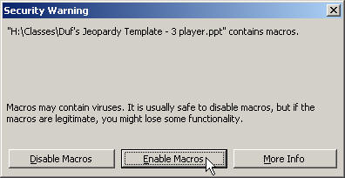
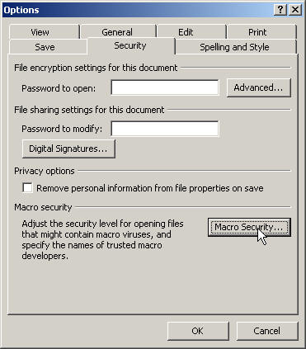
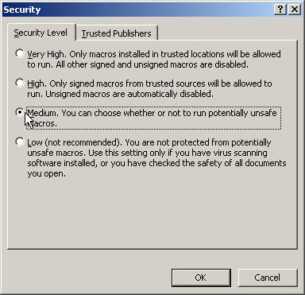
Macro Troubleshooting
If you’re having trouble getting this PowerPoint to work, be sure to “Enable Macros” when opening the file.
If you don’t see this box when you open PowerPoint, your security settings may be set too high. In this case, go to the “Tools” menu and select “Options.” Click on [Macro Security…] and then select “Medium.” Press OK until you return to the show. Now save this file and then re-open it. You should now receive the dialog shown above. Click “Enable Macros”
Note: some of the functions may not work with versions of PowerPoint other than PowerPoint 2010 for Windows

Slide 4

Board
E5
The Daily Double is located at:
Move to
reveal location
Instructions
Adj Scores
Reset
Double
Variable Roles
Data
Creating Code
Software Design
Digital Colors
Data Manipulation and OOP
$100
$100
$100
$100
$100
$100
$200
$200
$200
$200
$200
$200
$300
$300
$300
$300
$300
$300
$400
$400
$400
$400
$400
$400
$500
$500
$500
$500
$500
$500

Slide 5
This has a value assigned once and won't change
$100

Slide 6
What is a Fixed Variable?
$100

Slide 7
When serving this role, the variable will add to the value, often keeping a running total.
$200

Slide 8
What is an accumulator?
$200

Slide 9
A variable in this role will collect things into a list or similar structure.
$300

Slide 10
What is an aggregator?
$300

Slide 11
This might signal it is time to move on, or maybe someone has captured it.
$400

Slide 12
What is a One-Way Flag?
$400

Slide 13
Instead of just replacing the existing value, this variable will check to see if it is an improvement before storing the value.
$500

Slide 14
What is a Best-So-Far?
$500

Slide 15
There are only 10 types of people, those who understand it, and those who don't.
$100

Slide 16
What is binary?
$100

Slide 17
Binary math will limit this amount of data to a maximum of 255.
$200

Slide 18
What is one byte or eight bits?
$200
2^8 = 256 (0 to 255 is 256 possibilities)

Slide 19
The American Standard Code for Information Interchange stores characters with one byte each.
$300

Slide 20
What is ASCII?
$300

Slide 21
Hex requires 16 characters, starting at 0 and going to this.
$400

Slide 22
What is F?
$400

Slide 23
The main purpose is to reduce file size, but sometimes fidelity is sacrificed if it is lossy.
$500

Slide 24
What is compression?
$500

Slide 25
An If-Then block in Scratch is an example of this type of expression. It checks to see if something is true before proceeding.
$100

Slide 26
What is a Boolean expression or a conditional expression?
$100
If it is True it executes the code. If it is False, it skips the True part and goes to the Else or moves on in the code.

Slide 27
In Python this starts a function definition.
$200

Slide 28
What is def?
$200

Slide 29
These are needed after the name of a function in order to execute it.
$300

Slide 30
What are parentheses?
$300
Arguments, either optional or required, go inside the parentheses.

Slide 31
This will concatenate a string or add numbers.
$400

Slide 32
What is +?
$400

Slide 33
for n in range (5)
The third time through, n will be this.
$500

Slide 34
What is 2?
$500

Slide 35
Finding errors in a program and fixing them before they become a real pest.
$100

Slide 36
What is debugging?
$100
It is a good idea to program a little at a time and test frequently to keep bugs from piling up and errors are hard to find.

Slide 37
This shows the status of a program and where it can go to next (think Light Bot).
$200

Slide 38
What is a State Diagram?
$200

Slide 39
In contrast to waterfall design, this process provides for frequent testing and a shorter development cycle.
$300

Slide 40
What is Agile or Scrum?
$300
Frequent client input is also a characteristic of Agile design.

Slide 41
A checkpoint in development saved using Git.
$400

Slide 42
What is a commit?
$400

Slide 43
Either Data or Procedural, it allows us to ignore details in order to reduce complexity.
$500

Slide 44
What is Abstraction?
$500

Slide 45
In this digital representation of color, each component has 256 possible values (0 to 255).
$100

Slide 46
What is RGB?
$100
Each color component is stored using one byte (eight bits).

Slide 47
In an RGBA image, this determines opacity or transparency.
$200

Slide 48
What is alpha channel?
$200

Slide 49
This would give you the Red value of the 20th pixel in the 10th row in the object img
$300

Slide 50
What is img[9][19][0]
$300

Slide 51
Used when pasting with PIL, it determines what is made transparent in the new image.
$400

Slide 52
What is a mask?
$400
Also acceptable: Alpha channel

Slide 53
If this is true, you have a shade of gray.
$500

Slide 54
What is R=G=B?
$500

Slide 55
It returns the 4th element in a list called items
$100

Slide 56
What is items[3]?
$100

Slide 57
Returned by range(3)
$200

Slide 58
What is 0,1,2?
$200

Slide 59
len(img[0]) is a way to find this in an ndarray image object.
$300

Slide 60
What is the length of the first row, or the width of the image?
$300

Slide 61
Consists of class name, attribute names, and method names.
$400

Slide 62
What is a UML Diagram?
$400

Slide 63
When this is done to a class, an object is created.
$500

Slide 64
What is instantiation?
$500
The object will have the methods and attributes designated in the class.

Slide 65
DAILY
DOUBLE
Enter your wager:
$
Go!

Slide 66
Board
Move to
reveal location
D5
F2
The Daily Doubles are located at:
Move to
reveal location
Instructions
Adj Scores
Single
Final
GUIs
Images in Python
Data Types in Python
The Web
More Web
Visualizations and Simulations
$200
$200
$200
$200
$200
$200
$400
$400
$400
$400
$400
$400
$600
$600
$600
$600
$600
$600
$800
$800
$800
$800
$800
$800
$1000
$1000
$1000
$1000
$1000
$1000

Slide 67
Known by the acronym GUI.
$200

Slide 68
What is a Graphical User Interface?
$200

Slide 69
An event might be someone clicking a mouse. This part of a program will decide what to do in response.
$400

Slide 70
What is an Event Handler?
$400
Human Computer Interaction

Slide 71
The field of CS that focuses on how people and machines communicate.
$600

Slide 72
What is HCI?
$600

Slide 73
Interactions that rely on the sense of touch.
$800

Slide 74
What are haptics?
$800

Slide 75
A pattern that separates a program into the data, the observer and the controller.
$1000

Slide 76
What is MVC pattern?
$1000
Model – View – Controller

Slide 77
import matplotlib.pyplot as plt
This keyword brings the resource into your code so you can use it.
$200

Slide 78
What is import?
$200

Slide 79
import matplotlib.pyplot as plt
This is the short name given to the matplotlib.pyplot module.
$400

Slide 80
What is plt?
$400

Slide 81
import matplotlib.pyplot as plt
This is the name of the library being imported.
$600

Slide 82
What is matplotlib?
$600

Slide 83
import matplotlib.pyplot as plt
This is the module that we want to use.
$800

Slide 84
What is pyplot?
$800

Slide 85
For the ndarray object img, len(img gives you this.
$1000

Slide 86
What is the height of the image?
$1000
It will give you the number of rows, which will be the height.

Slide 87
This data type consists of whole numbers and their opposites.
$200

Slide 88
What is integer or int?
$200

Slide 89
This type of data will always have a decimal point.
$400

Slide 90
What is float?
$400

Slide 91
True or False, nothing else.
$600

Slide 92
What is Boolean?
$600

Slide 93
Most of the time it is text, but it really can be any characters.
$800

Slide 94
What is a String?
$800

Slide 95
Similar in form to a list, but immutable.
$1000

Slide 96
What is a tuple?
$1000
Tuples cannot have their members reassigned.

Slide 97
Provides a human-friendly address for internet destinations.
$200

Slide 98
What is DNS?
$200

Slide 99
More surreptitious than sweet, these keep track of your activities online so pages can tailor your experience.
$400

Slide 100
What are cookies?
$400

Slide 101
The .org in http://samplehs.pltwcs.org/students/bkiGag3/sample.php?f=2
$600

Slide 102
What is the top level domain?
$600

Slide 103
Verbosely, the World Wide Web Consortium. It develops web standards.
$800

Slide 104
What is the W3C?
$800

Slide 105
SYN 6, ACK 7, SYN 34, ACK 35
$1000

Slide 106
What is a TCP Handshake?
$1000

Slide 107
The proper way to close the body of html.
$200

Slide 108
What is </body>?
$200

Slide 109
A tool external to a webpage for setting font and background color.
$400

Slide 110
What is CSS (Cascading Style Sheet)?
$400

Slide 111
Use this to encrypt a message for someone else using Public Key encryption.
$600

Slide 112
What is the recipient’s public key?
$600

Slide 113
Since JavaScript is executed in the browser, it is a good example of this.
$800

Slide 114
What is client side scripting?
$800

Slide 115
This can combine data across several MySQL tables into one result.
$1000

Slide 116
What is a JOIN command?
$1000
Used in a query

Slide 117
Any tool that uses a graph or a picture to extract meaning from data.
$200

Slide 118
What is a visualization?
$200
Histograms, Pie Graphs, Bar Graphs, Line Graphs

Slide 119
Histograms are a good way to visualize this in data.
$400

Slide 120
What is frequency?
$400

Slide 121
Individuals programmed to follow rules within specific parameters.
$600

Slide 122
What is Agent Based Simulation
$600

Slide 123
Unprogrammed behaviors that appear suddenly.
$800

Slide 124
What is emergent behavior?
$800

Slide 125
Both self-similar and infinite in detail.
$1000

Slide 126
What is a fractal?
$1000

Slide 127
DAILY
DOUBLE
Enter your wager:
$
Go!

Slide 128
DAILY
DOUBLE
Enter your wager:
$
Go!

Slide 129
Internet Search
Automated programs that index websites for search engines.
Final
Jeopardy
Reveal Prompt
Reveal Response

Slide 130
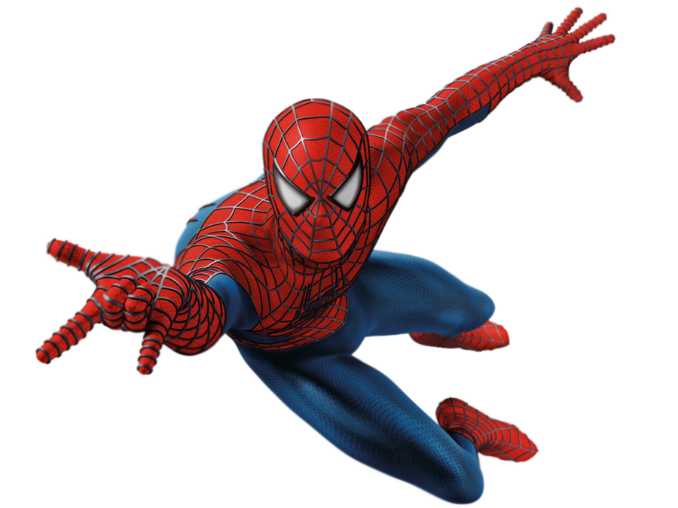
Spiders or Web Crawlers
Incorrect
Correct
Incorrect
Correct
Incorrect
Correct
Incorrect
Correct

